Slide 1
HOW TO USE DENSE OPTICAL FLOW TO TRACK CELL MOTION
Timothy Tyree
Rappel Group – Univ. of Calif., San Diego
3.9.2020

Slide 2
OUTLINE
Nota bene: I will not cover the details how dense optical flow works in this talk.
What is dense optical flow?
Why should I use dense optical flow?
Which algorithm is best?
Brief flashy example
A step-by-step example

Slide 3
What is dense optical flow?
Dense optical flow is a way to estimate movement between two images that provides a displacement vector for every pixel.

Slide 4
Why should I use dense optical flow?
Dense optical flow is
Compare to single cell tracking, which is
agnostic to the tedium of single cell tracking
easy to use!
prone to error when
particles/cells are indistinguishable
particles/cells cross paths
particles/cells get too close or bump into one another
hard to scientifically verify because
results tend to be more sensitive to parameter choices

Slide 5

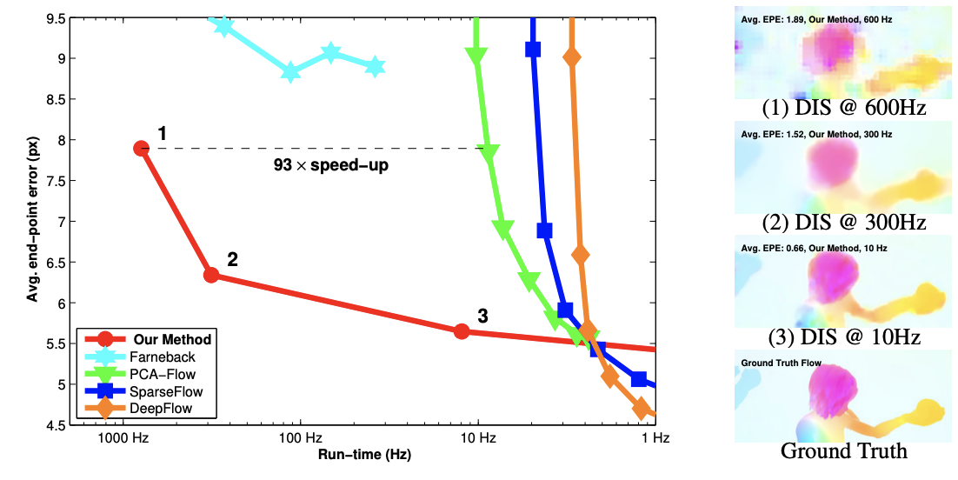

Which algorithm is best?
Kroeger et al., “Fast Optical Flow using Dense Inverse Search”, Computer Science (2016) arXiv:1603.03590
Dense Inverse Search optical flow (red line) offers a great tradeoff between speed and accuracy compared to other dense optical flow algorithms, and it is therefore best for most applications.

Slide 6
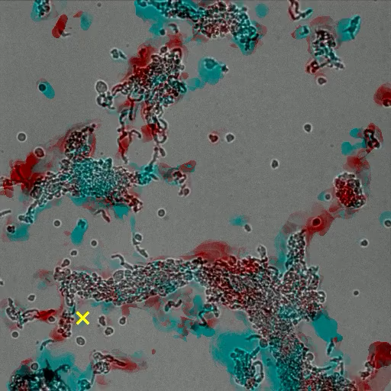
A Flashy Example: tracking Radial Cell Motion
Red = towards cluster center
Blue = away from cluster center
Yellow x = cluster center

Slide 7
Now, a step-by-step example: cell motion constrained to the horizontal direction

